Slide 1

respecting children’s voices in play and learning early years conference ccsa and eca nsw crown plaza, hunter valley
Megan Mitchell
National Children’s Commissioner
18 October 2013
Notes:
Acknowledgments.

Slide 2
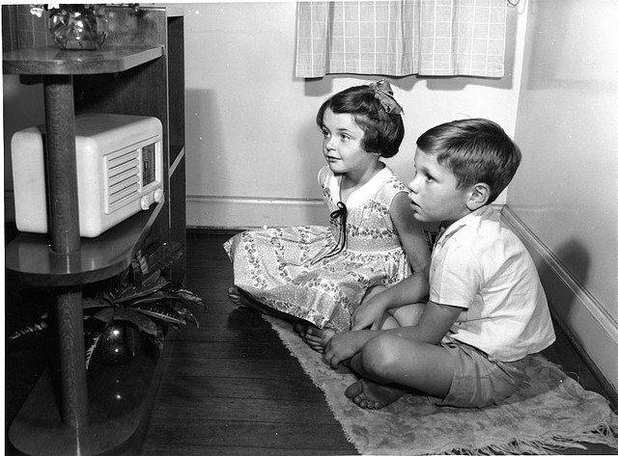
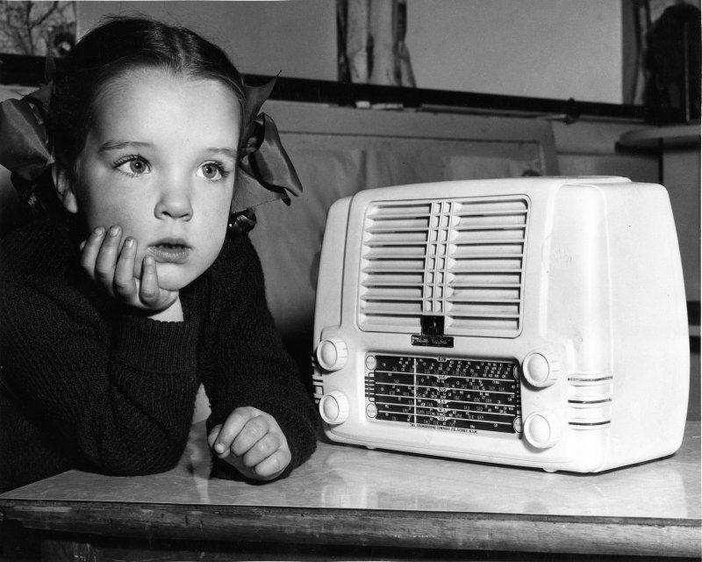

Slide 3
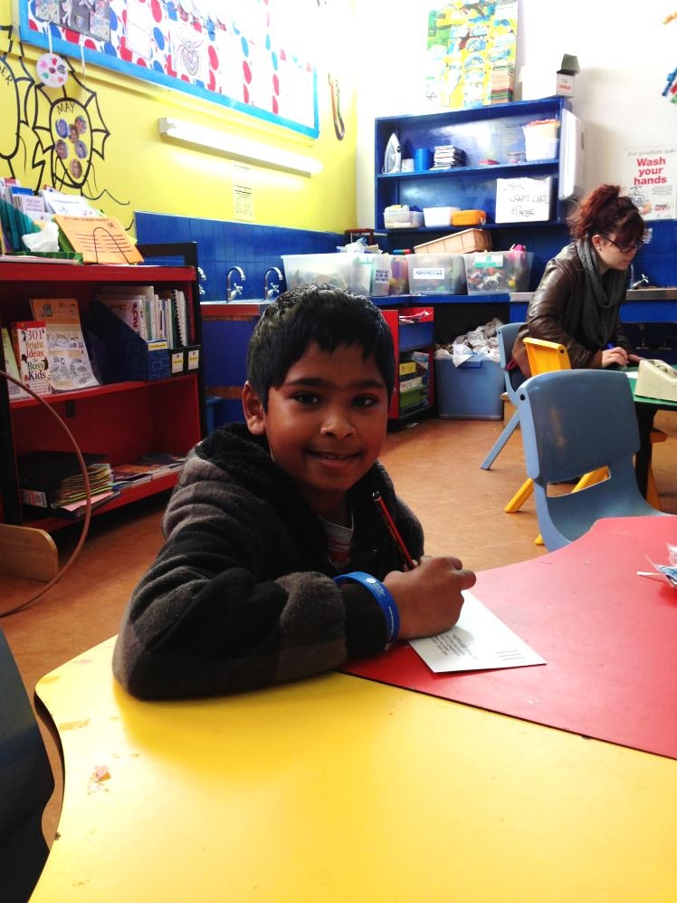
The right to be heard and the right to play

Slide 4
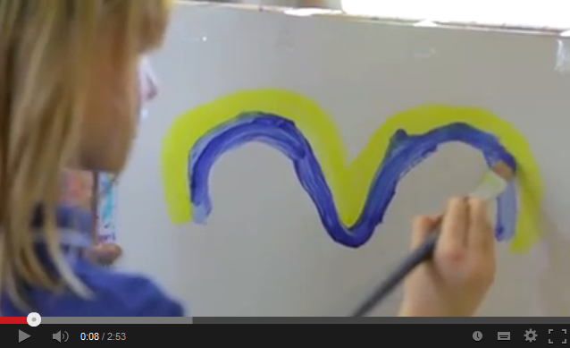
A conversation about play

Slide 5
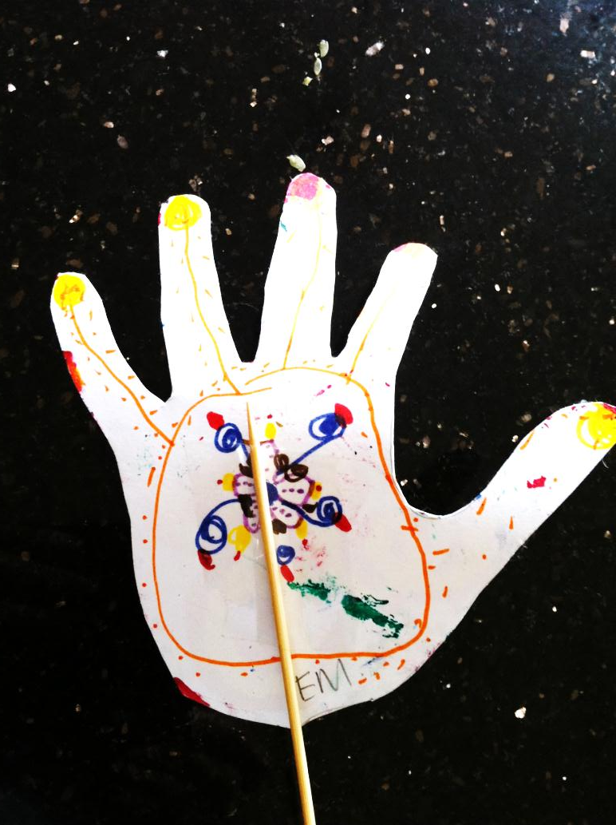
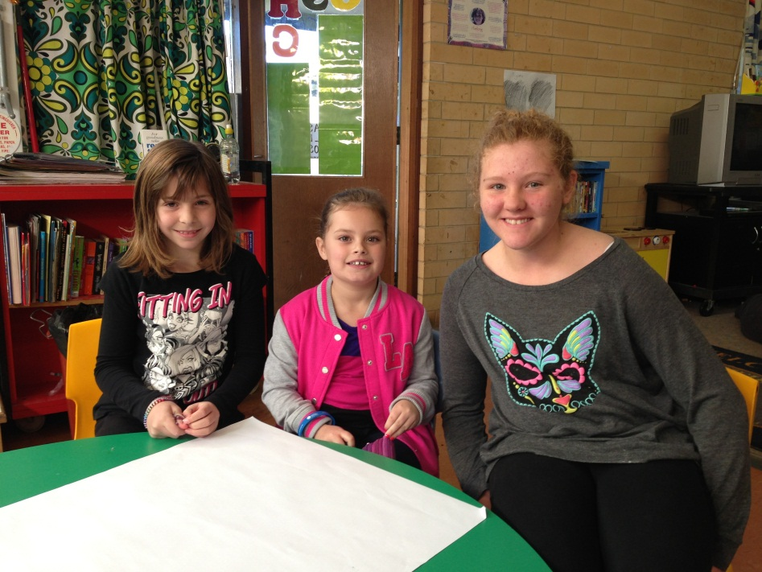
Importance of play

Slide 6
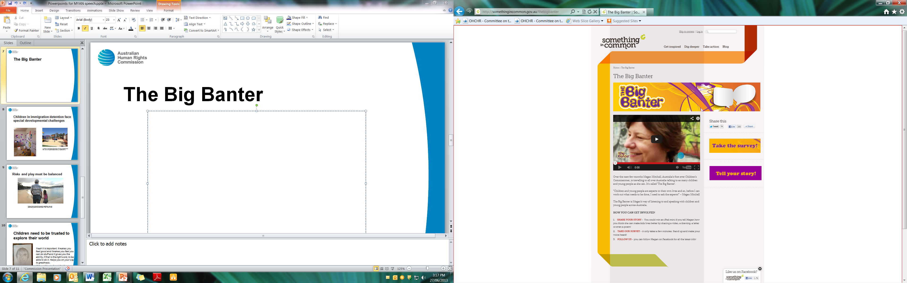
The Big Banter

Slide 7
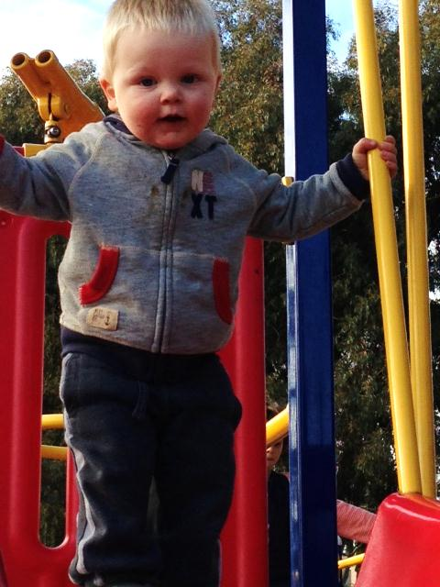
Respecting the child’s voice in play and all matters affecting them

Slide 8
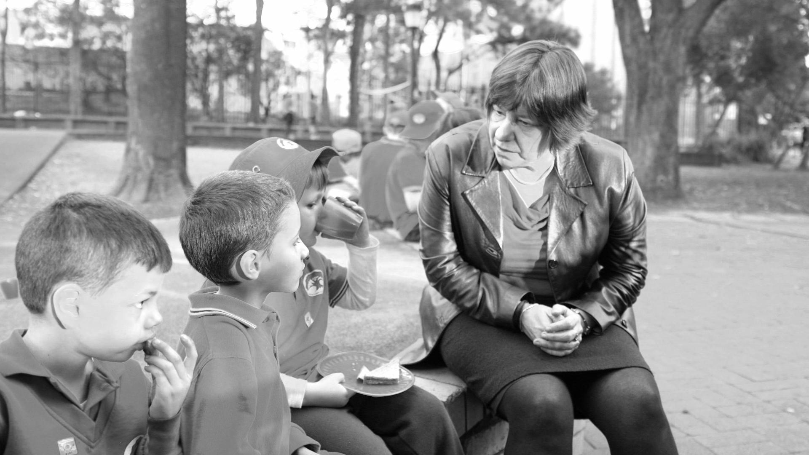
What do children themselves say?
What if we had personal robot butlers
How about a kid Prime Minister
Imagine if every kid had a rocket!
Everyone should live in castles

Slide 9
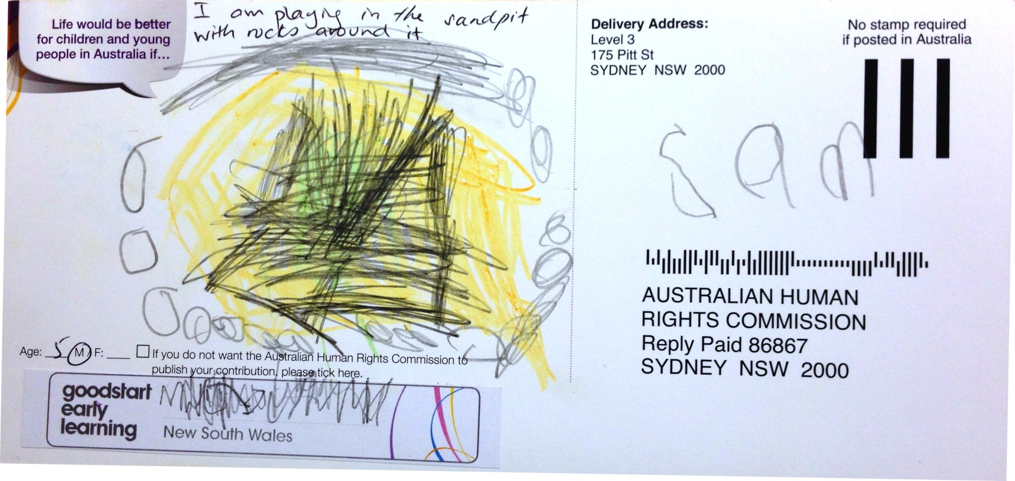
What do children themselves say?
6 Week Old Baby
“Normal” brain
6 Week Old Baby
“Foetal Alcohol Syndrome” brain

Slide 10
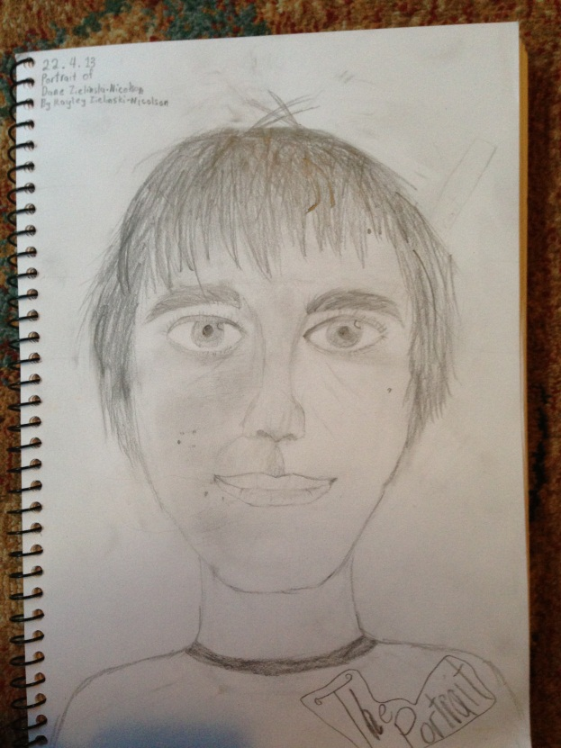
What do children themselves say?
“
I’m happiest when playing with my friends at day care on the climbing frame. .
”

Slide 11
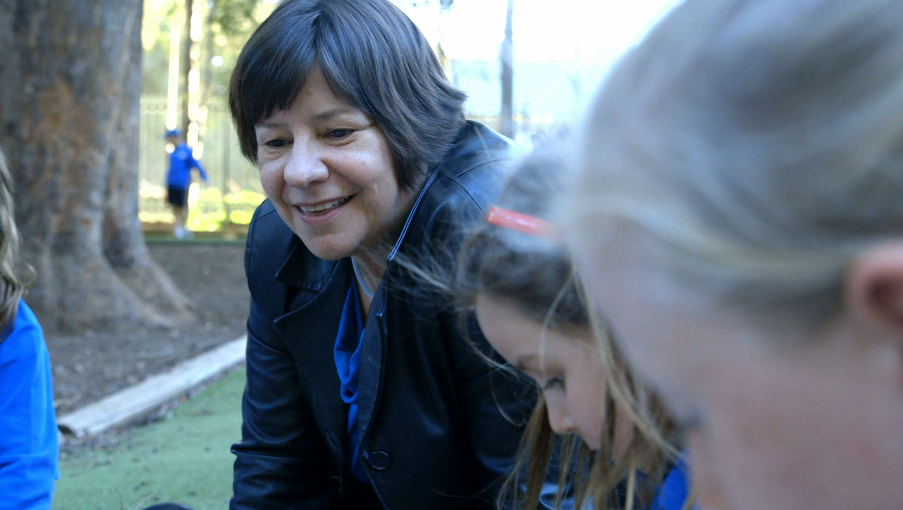
Newtown OSHC, NSW
Photo of Commissioner Mitchel with children at North Newton OSHC, NSW (29 July 2013)

Slide 12
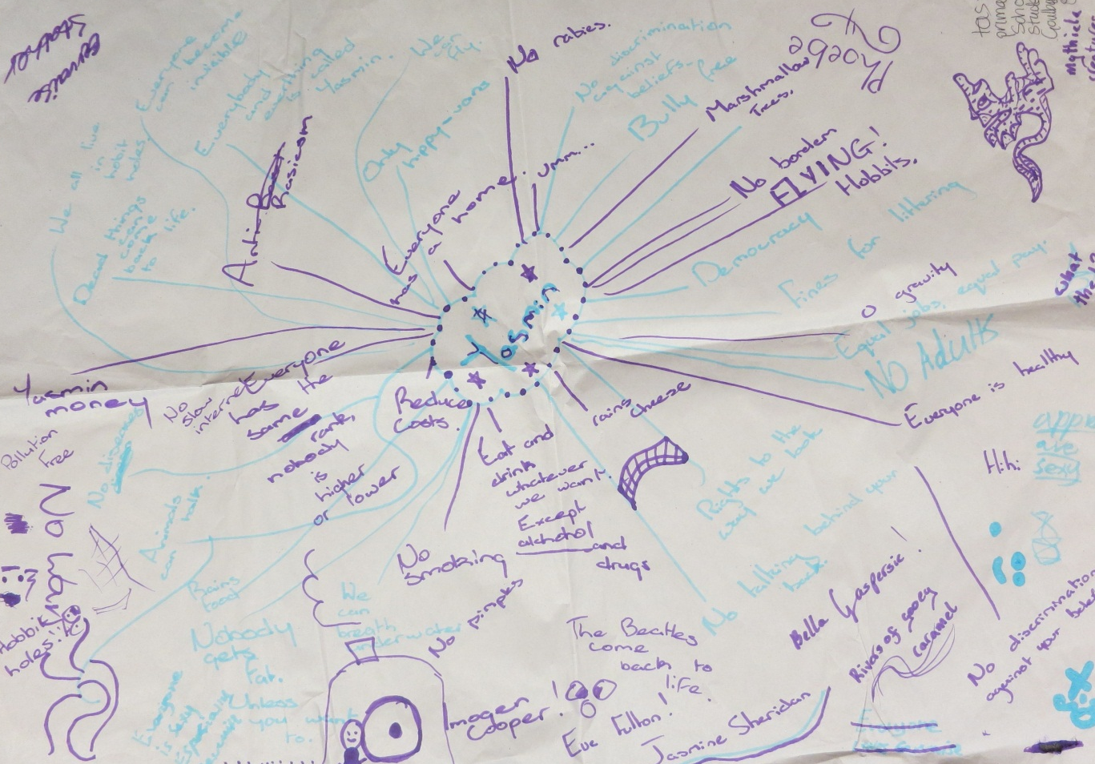
Goulburn Street Primary School, TAS
Photo of drawings by children at Goulburn Street Primary School, TAS (24 June 2013)

Slide 13
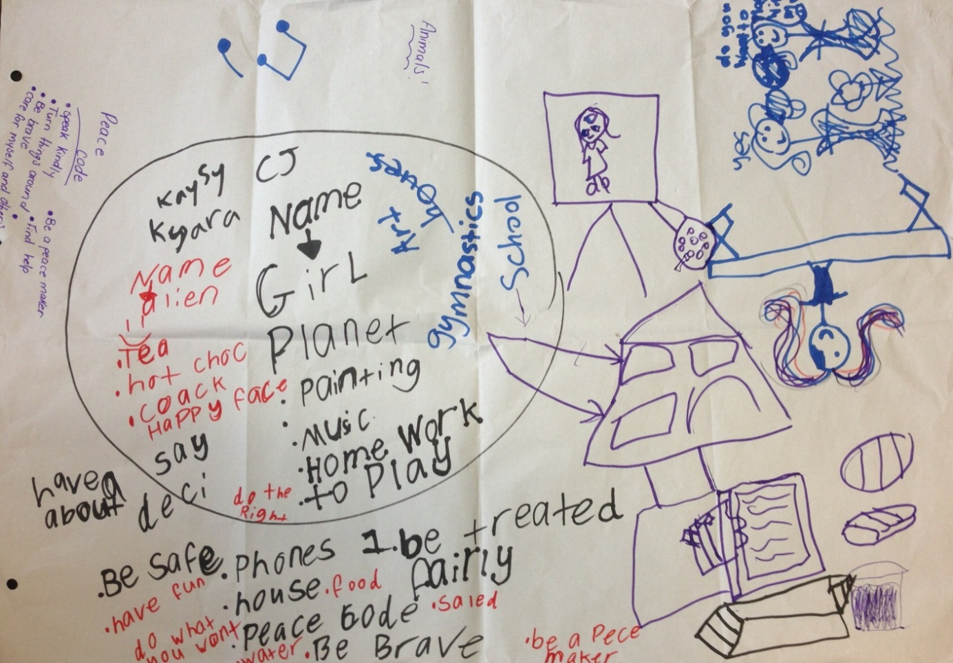
Northfield OSHC, SA
Photo of drawings by children at Northfield OSHC, SA (10 July 2013)

Slide 14
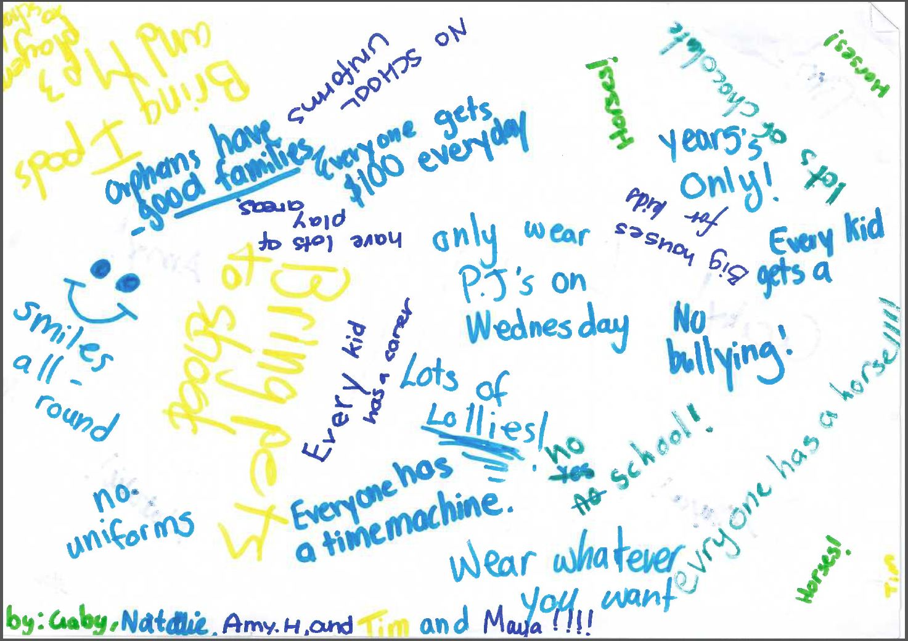
Burgmann OSHC, ACT
Photo of drawings by children at Burgmann OSHC, ACT (30 May 2013)

Slide 15
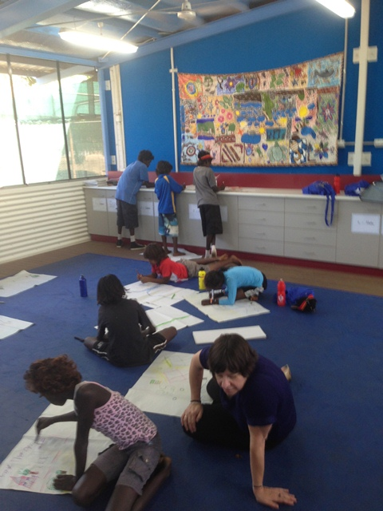
Belyuen Primary School, NT
“
The roads should be good so we can get around.
”
Photo of Commissioner Mitchell and children at Belyuen Primary School, NT (7 August 2013)

Slide 16
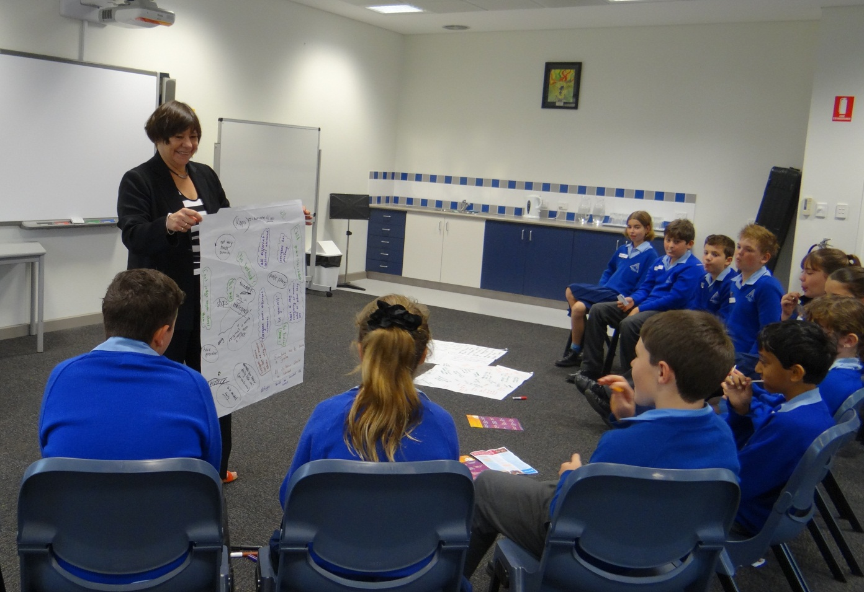
Sacred Heart Primary School, WA
Photo of Commissioner Mitchell and children at Sacred Heart Primary School, WA (15 August 2013)

Slide 17
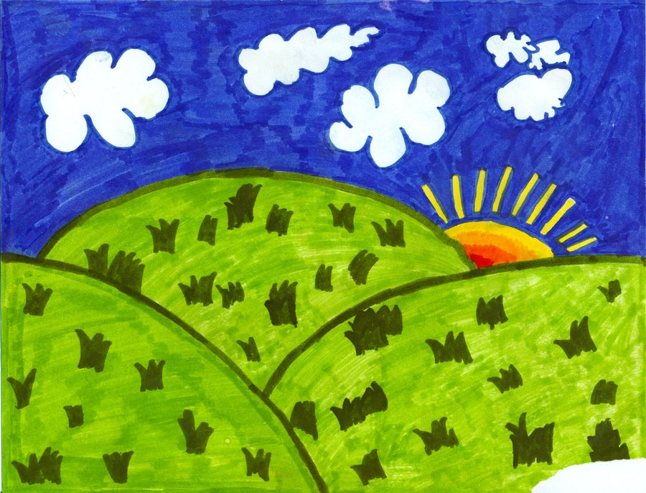
6 Week Old Baby
“Normal” brain
6 Week Old Baby
“Foetal Alcohol Syndrome” brain

